Slide 1
AlphaNo.ai
Final Presentation
Mohit Gayatri (mag9528), Emily Hao (yh4247), Sukrit Rao (str8775), Dhruv Saxena (ds6802)
Spring 2023
Notes:
Outline
Problem Definition - Emily
What is transfer learning and how are we applying it?
Related Work - Dhruv
Stanford paper we used - https://web.stanford.edu/class/cs234/CS234Win2020/past_projects/2017/2017_Asawa_Elamri_Pan_Transfer_Learning_Paper.pdf
Deepmind paper (PPO) - https://arxiv.org/pdf/1707.06347.pdf
DDPG paper - https://arxiv.org/pdf/1509.02971.pdf
Experiment Setup (SUKRIT)
MuJoCo + Dm control + gym
Which domains did we use?
Walker, hopper, cartpole, finger, reacher
CNN network choice
Hyperparameter choice
Agent Noise
State Dependent Exploration
What did we try to transfer between
What algorithm did we use and why?
Results (SUKRIT)
Tensorboard graphs of rewards
Takeaways
%-change (or something else) to show the effect of transfer learning

Slide 2
Overview
01

Slide 3
Transfer Learning
Transfer learning in RL refers to the process of leveraging knowledge or skills learned from one RL task to improve learning or performance on a different, but related RL task.
It involves transferring information, policies, or value functions acquired from a source to a target task, which may have different dynamics, reward structures, or state spaces.
The motivation behind transfer learning is to accelerate learning and improve the sample efficiency of RL algorithms.
Instead of starting from scratch, an agent can benefit from the pre-existing knowledge gained. Transfer learning is particularly useful when there is a limited amount of data or when training RL agents can be time-consuming or costly.

Slide 4
Application of Transfer Learning in RL
There are several ways transfer learning can be applied in RL:
Policy Transfer: In this approach, the policy learned from the source task is directly applied to the target task. Ideally the transferred policy provides a good starting point for the target task and reduces the time required for learning.
Value Function Transfer: Transferring the value function learned from the source task to the target task by initializing the value function of the target task with the values obtained from the source task.
Knowledge Transfer through Experience Replay: The replay buffer from the source task can be used to augment the replay buffer of the target task. This allows the agent to learn from a broader set of experiences and potentially generalize better.
Notes:
dm_control
Mujoco was first created by OpenAI and then acquired by DeepMind- better maintenance and support
we can get access to pixels from observation space.
Also has access to more domains and tasks that are not present in GYM
Give examples or counts
Converted to gym environment for training, easier to add our own custom CNN networks for training

Slide 5
Application of Transfer Learning in RL Cont.
Additional ways transfer learning can be applied in RL:
Feature Transfer: transferring learned feature representations from the source task to the target task. By extracting useful and generalizable features from the source task, the agent can focus on learning task-specific features during the target task.
Model Transfer: If the agent has access to a learned model of the environment from the source task, it can be used to initialize or guide the learning process in the target task. The model can provide a useful approximation of the target task's dynamics and help reduce the sample complexity of learning.
Notes:
dm_control
Mujoco was first created by OpenAI and then acquired by DeepMind- better maintenance and support
we can get access to pixels from observation space.
Also has access to more domains and tasks that are not present in GYM
Give examples or counts
Converted to gym environment for training, easier to add our own custom CNN networks for training

Slide 6
Related
Work
02

Slide 7
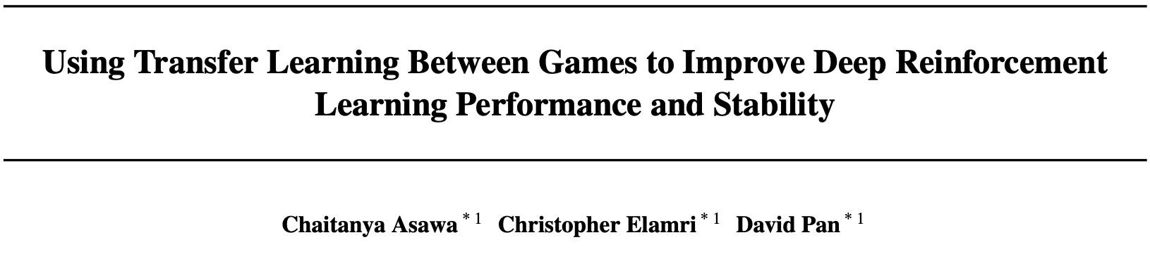
Synopsis -
Games Used : Snake and PuckWorld
Main Idea : Chose games which have similar movements, but relatively different end goals and environments.
Methodology : Explored different methods of transferring weights with Deep Q-Learning Networks and Dueling Network architectures.
“The idea behind transfer learning is that generalization can occur not only within tasks, but also across tasks.”

Slide 8
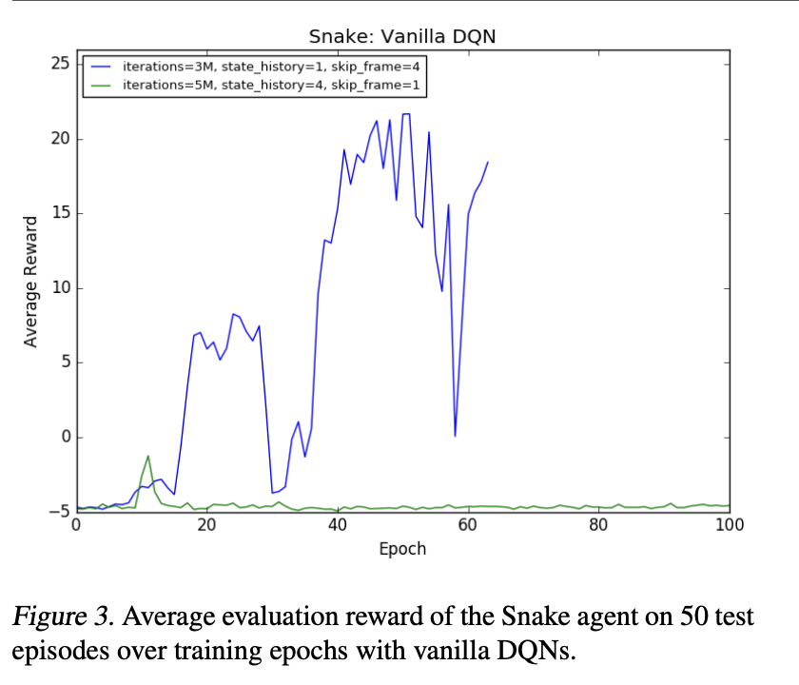
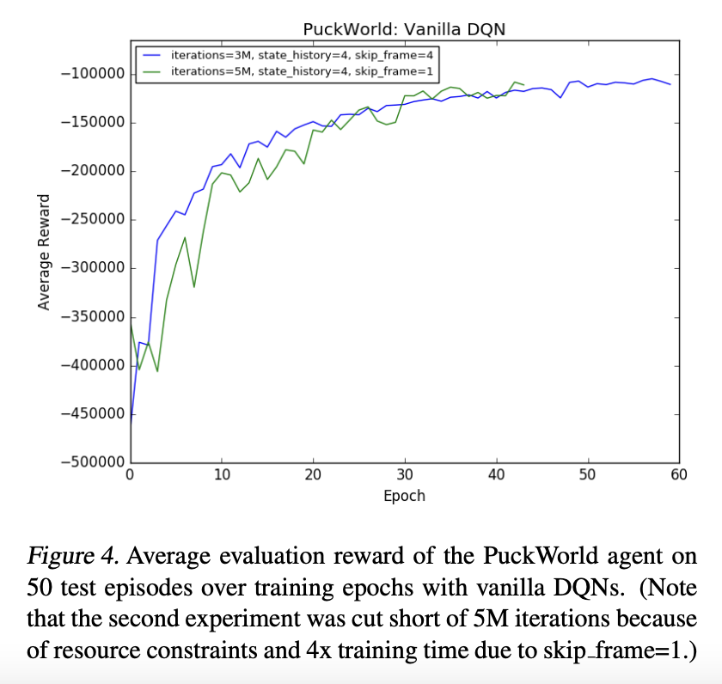
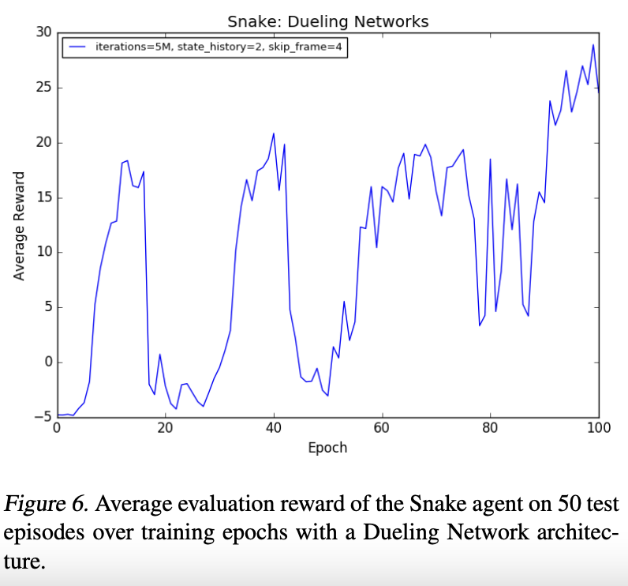
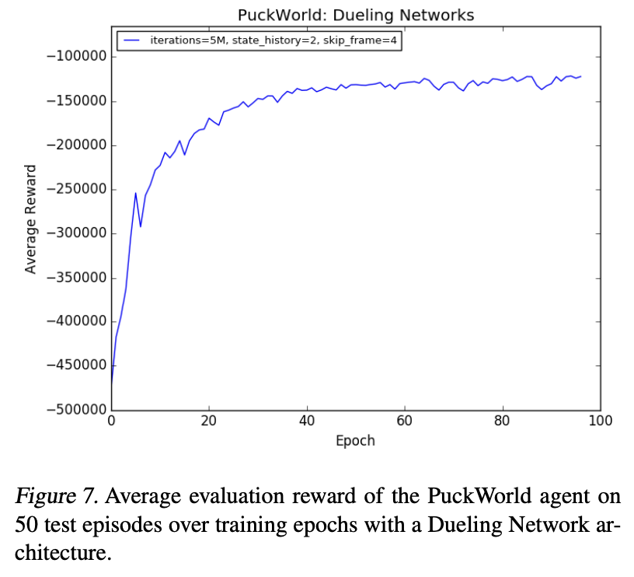
Results : PuckWorld Linear, Snake Oscillatory

Slide 9
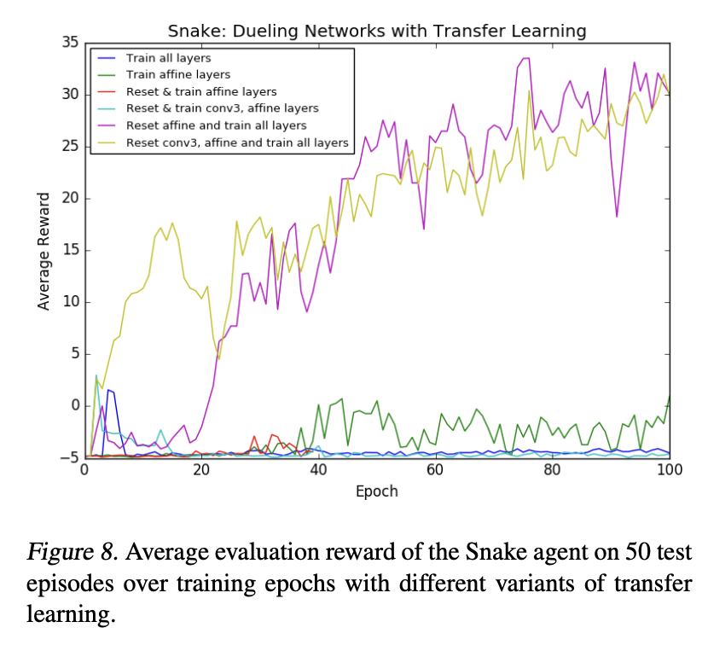
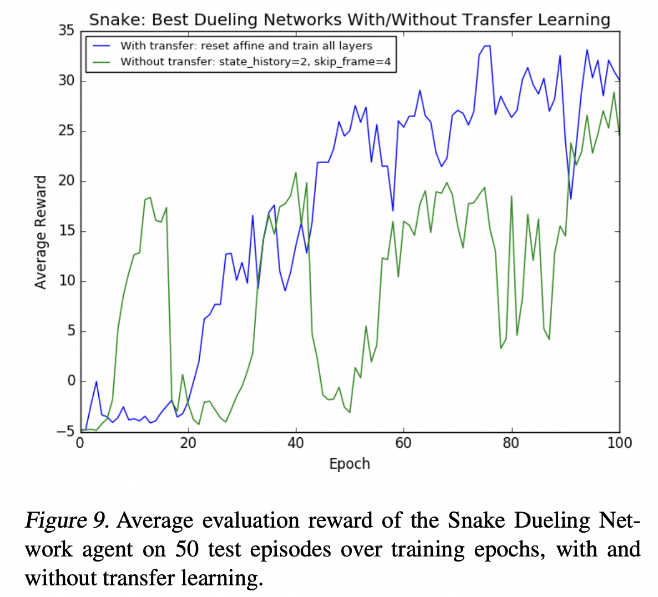
Results : Transfer Learning to the rescue.

Slide 10
Experiment
Details
03

Slide 11
Experiment Details
Environment Setup
Used DeepMind Control Suite (dm_control¹) to instantiate env
convenient Python bindings for MuJoCo physics simulations
access to low-level APIs for custom implementations
access to pixel information from observation space
pre-built benchmarking environments enable faster experimentation
¹https://github.com/deepmind/dm_control
²https://github.com/denisyarats/dmc2gym
³https://github.com/openai/gym
⁴https://github.com/DLR-RM/stable-baselines3
Notes:
dm_control
Mujoco was first created by OpenAI and then acquired by DeepMind- better maintenance and support
we can get access to pixels from observation space.
Also has access to more domains and tasks that are not present in GYM
Give examples or counts
Converted to gym environment for training, easier to add our own custom CNN networks for training

Slide 12
Experiment Details
Environment Setup - II
Used dmc2gym² package to convert dm_control env to OpenAI Gym³ env
Python-based Gym wrapper for DeepMind Control Suite
Exposes Gym APIs for training and inference with underlying dm_control env
Used stable-baselines3⁴ for network training
¹https://github.com/deepmind/dm_control
²https://github.com/denisyarats/dmc2gym
³https://github.com/openai/gym
⁴https://github.com/DLR-RM/stable-baselines3
Notes:
dm_control
Mujoco was first created by OpenAI and then acquired by DeepMind- better maintenance and support
we can get access to pixels from observation space.
Also has access to more domains and tasks that are not present in GYM
Give examples or counts
Converted to gym environment for training, easier to add our own custom CNN networks for training

Slide 13
Experiment Details
Environment Setup- Domains and Tasks
Domain: Refers to a class of physical models (eg: cartpole, walker)
Task: Refers to a specific instance of a physical model with a particular MDP structure (eg: cartpole-swingup, cartpole-balance)
DM Control Suite provides over 28 different domains, each with their own set of tasks.
Notes:
dm_control
Mujoco was first created by OpenAI and then acquired by DeepMind- better maintenance and support
we can get access to pixels from observation space.
Also has access to more domains and tasks that are not present in GYM
Give examples or counts
Converted to gym environment for training, easier to add our own custom CNN networks for training

Slide 14
Experiment Details
Environment Setup- Domains and Tasks
Domain | Pretrain Task | Transfer Task
Walker | Stand | Walk
Finger | Turn Easy | Turn Hard
Reacher | Easy | Hard
Cartpole | Swingup | Swingup Sparse
List of Domains and Tasks Included in our Experiments
Notes:
dm_control
Mujoco was first created by OpenAI and then acquired by DeepMind- better maintenance and support
we can get access to pixels from observation space.
Also has access to more domains and tasks that are not present in GYM
Give examples or counts
Converted to gym environment for training, easier to add our own custom CNN networks for training

Slide 15
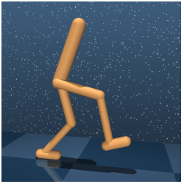
Experiment Details
Walker - Stand & Walk tasks
Notes:
Walker
- reward for ‘stand’ task is a constant for each timestep spent standing upright (minimal torso height)
- reward for ‘walk’ task is a constant multiplied by forward velocity

Slide 16
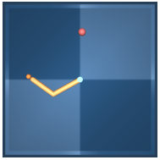
Experiment Details
Reacher - Easy & Hard tasks
Notes:
Reacher - 2-link planar arm that is rewarded when it’s red arm overlaps with target sphere. For hard task, sphere is smaller.

Slide 17
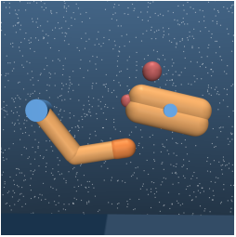
Experiment Details
Finger - Turn Easy & Turn Hard tasks
Notes:
Finger - 3-DOF planar finger planar ‘finger’ that is required to rotate a body on an unactuated hinge. In the turn_easy and turn_hard tasks, the tip of the free body must overlap with a target (the target is smaller for the turn_hard task).

Slide 18
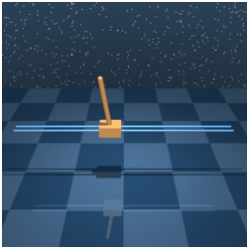
Experiment Details
Cartpole - Swingup & Swingup-sparse tasks
Notes:
Cartpole - Swing-up an unactuated pole by applying forces to a cart at its base, starting with the pole pointing downward. Swing-up sparse
only rewards if the cart and pole are within specified x and y ranges.

Slide 19
Experiment Details
Environment Setup- Action and Obs Space
Observation Space
Physics variables such as
positional coords in different frames of reference,
relative velocity and acceleration of joints,
Images (pixel information) from different points of views
For our experiments we utilize only the pixel information
Action Space
Torque applied to various joints
Values are between -1 and 1 (continuous domain)
Notes:
dm_control
Mujoco was first created by OpenAI and then acquired by DeepMind- better maintenance and support
we can get access to pixels from observation space.
Also has access to more domains and tasks that are not present in GYM
Give examples or counts
Converted to gym environment for training, easier to add our own custom CNN networks for training

Slide 20
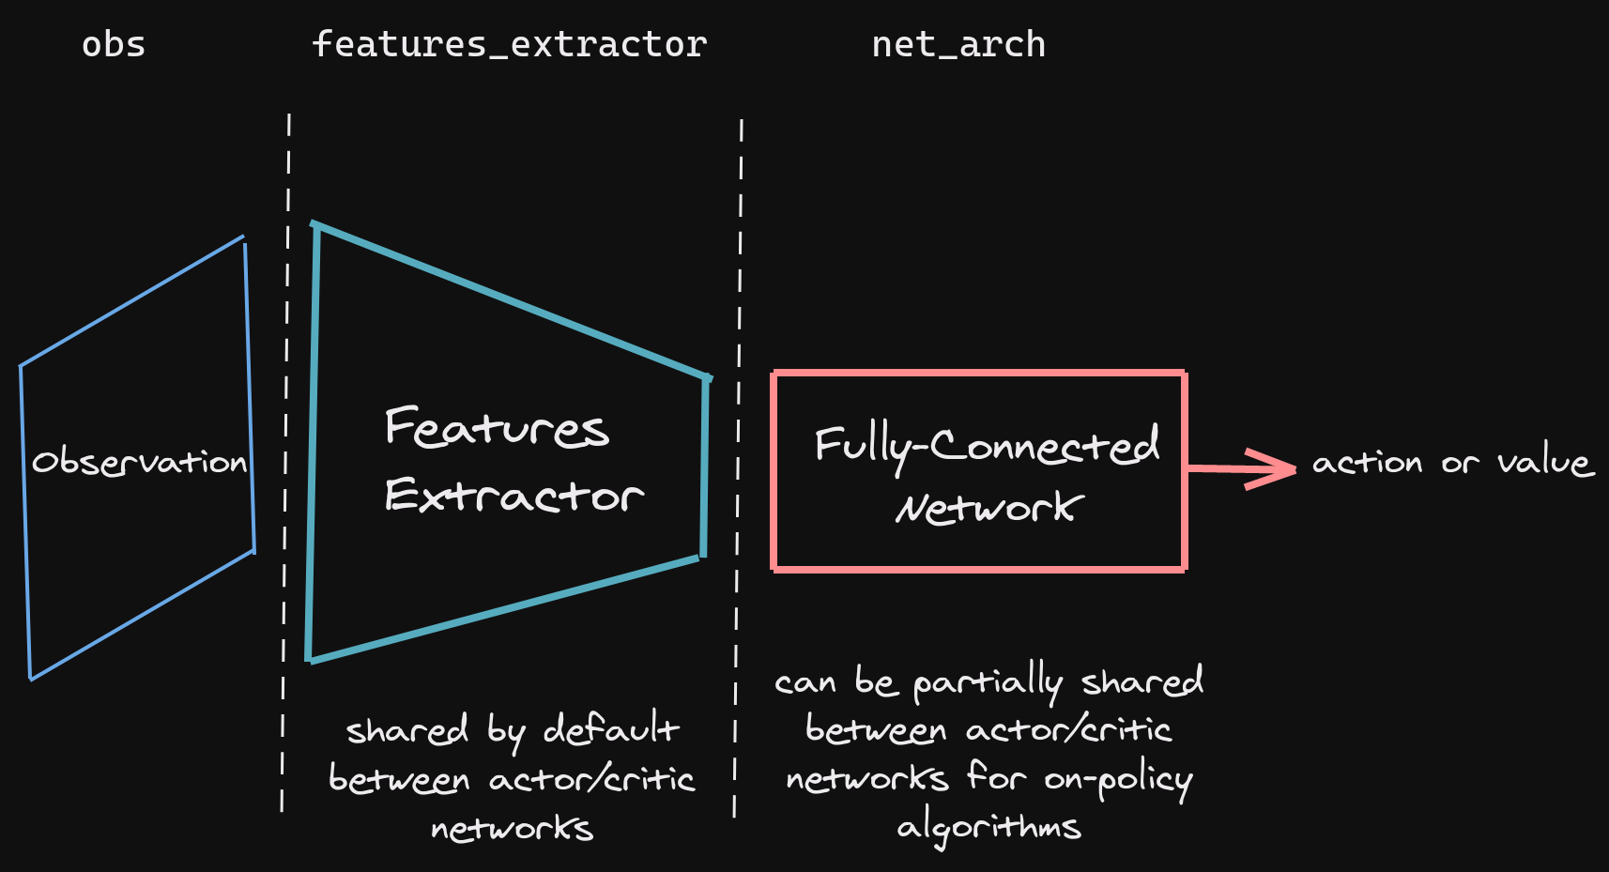
Experiment Details
Algorithm Details
Policy-based algorithms such as PPO and DDPG since action space is continuous
Fed image pixels to custom feature extractor followed by projection layer to action space
Image taken from https://stable-baselines3.readthedocs.io/en/master/guide/custom_policy.html
Notes:
Continuous action space (torque vector on joints) so we used policy-based algorithms like PPO and DPPG that are better suited to these types of problems

Slide 21
Experiment Details
CNN Feature Extractors
CNN Used | Number of Parameters
Atari Nature (Default) | ~175,000
Resnet 18 | 11,000,000
Deepmind 1 | ~410,000
Deepmind 2 | ~480,000
Notes:
CNN details
Atari Nature - CNN used in original 2015 DQN nature paper
Resnet 18 - CNN used in ResNet paper
Deepmind 1 - CNN used in 2016 DDPG paper by deepmind
Deepmind 2 - Same as Deepmind 1, with different stride and padding values

Slide 22
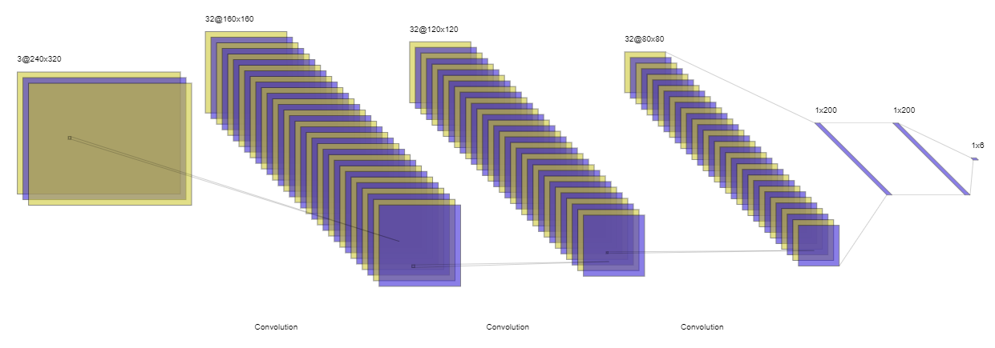
Experiment Details
Deepmind 1 CNN architecture
Notes:
Deepmind 1 CNN architecture
3 convoultional layers with 32 filters each
2 fully connected layers with 200 neurons each

Slide 23
Experiment Details
Evaluation Details
Max Mean Reward (MMR)
What is the maximum mean episodic reward achieved by the agent?
Numeric, easily quantifiable
Steps to High Reward
Number of steps taken to reach within 5% of max mean reward
Rough estimate of how long the model took to achieve peak performance

Slide 24
Experiment Details
Challenges
Environment Setup
Sequential experimental setup for transfer learning
Heavy Compute Requirements
Large number of steps required for optimization (>2M steps)
DDPG uses a very large experience replay buffer (>200GB)
Low GPU utilization
Relatively simple feature extractor arch
Large experience buffer
Notes:
Env setup
Compute resource
Experience replay memory
Number of steps
GPUs but low utilization

Slide 25
Results
04

Slide 26
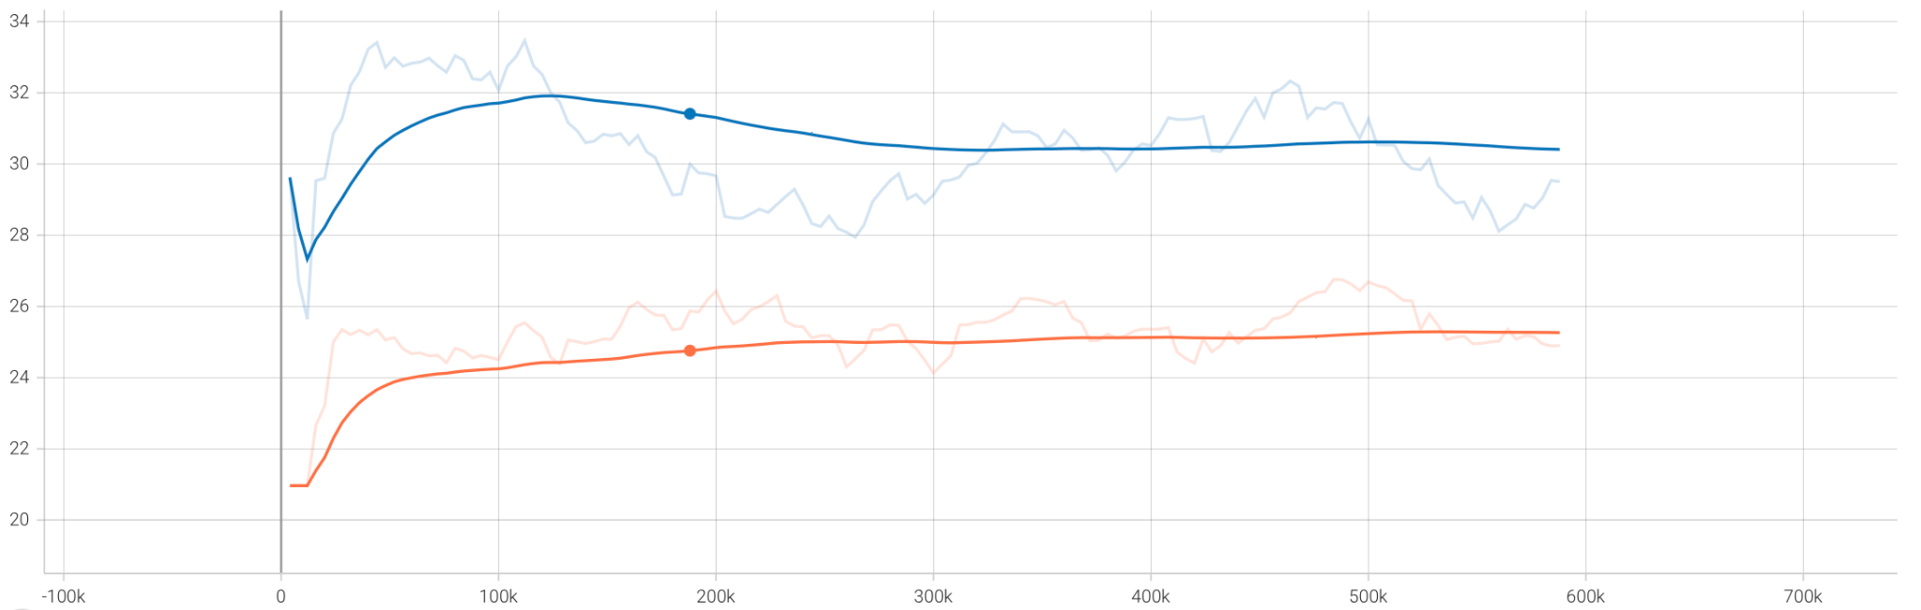
Results
Walker - Walk task with DDPG
Baseline
Transfer
Metric | Baseline | Transfer Learning | Improvement
Max Mean Reward | 26.3 | 33.8 | 28.5% higher
Steps to High Reward | 190,000 | 80,000 | 110,000 lower

Slide 27
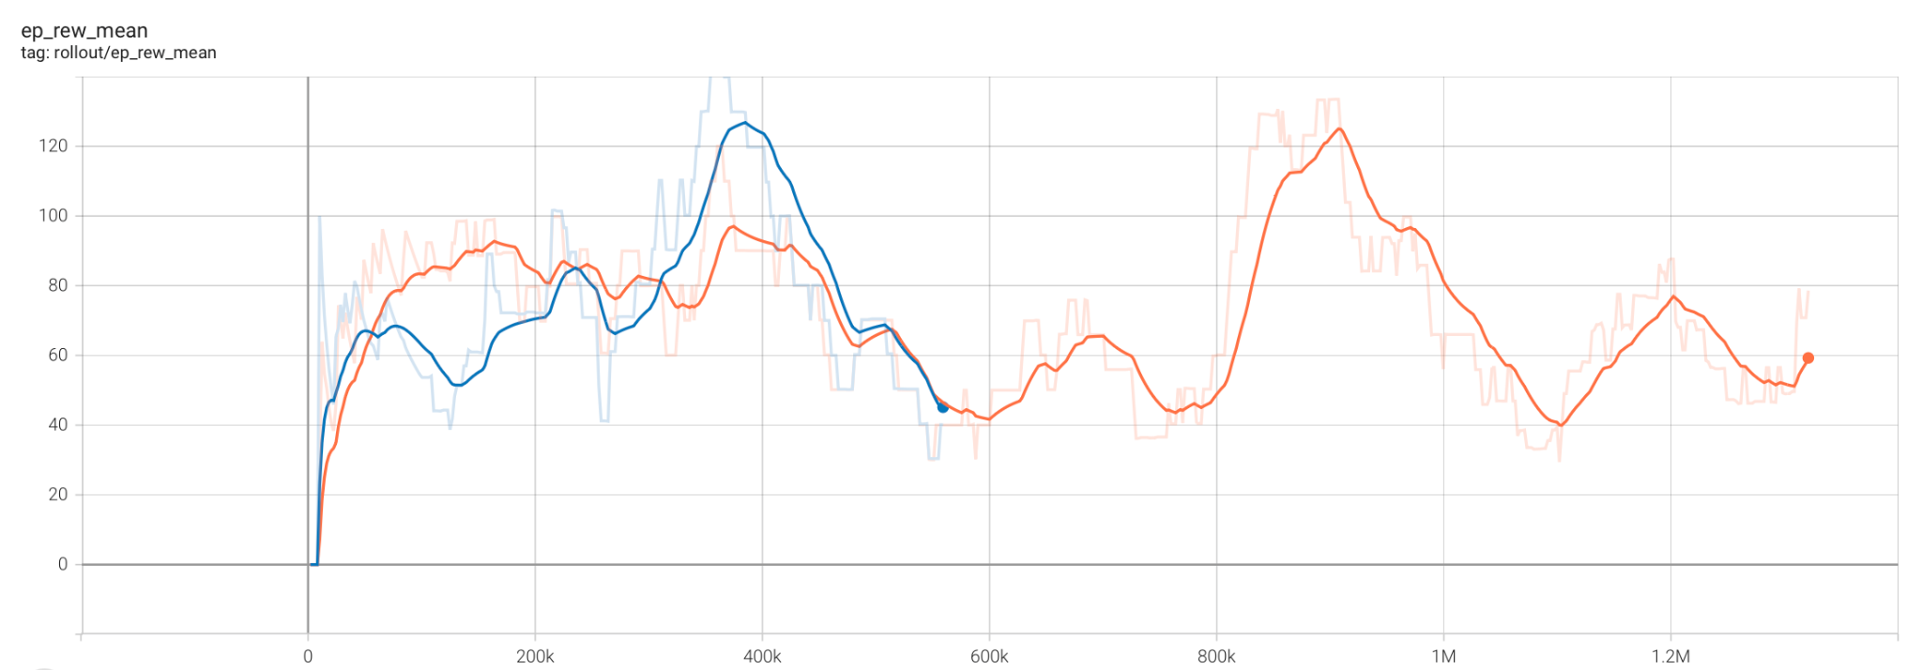
Results
Finger - Turn_Hard task with PPO
Baseline
Transfer
Metric | Baseline | Transfer Learning | Improvement
Max Mean Reward | 121.9 | 122.1 | 0.002% higher
Steps to High Reward | 880,000 | 380,000 | 500,000 lower

Slide 28
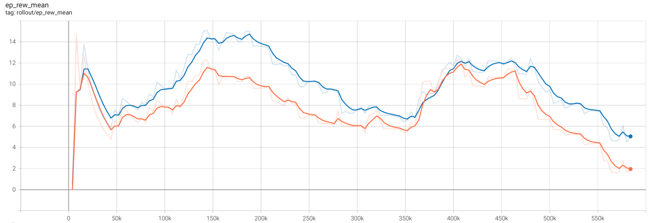
Results
Reacher - Hard task with DDPG
Baseline
Transfer
Metric | Baseline | Transfer Learning | Improvement
Max Mean Reward | 11.9 | 14.3 | 20.1% higher
Steps to High Reward | 28,000 | 120,000 | 92,000 higher

Slide 29
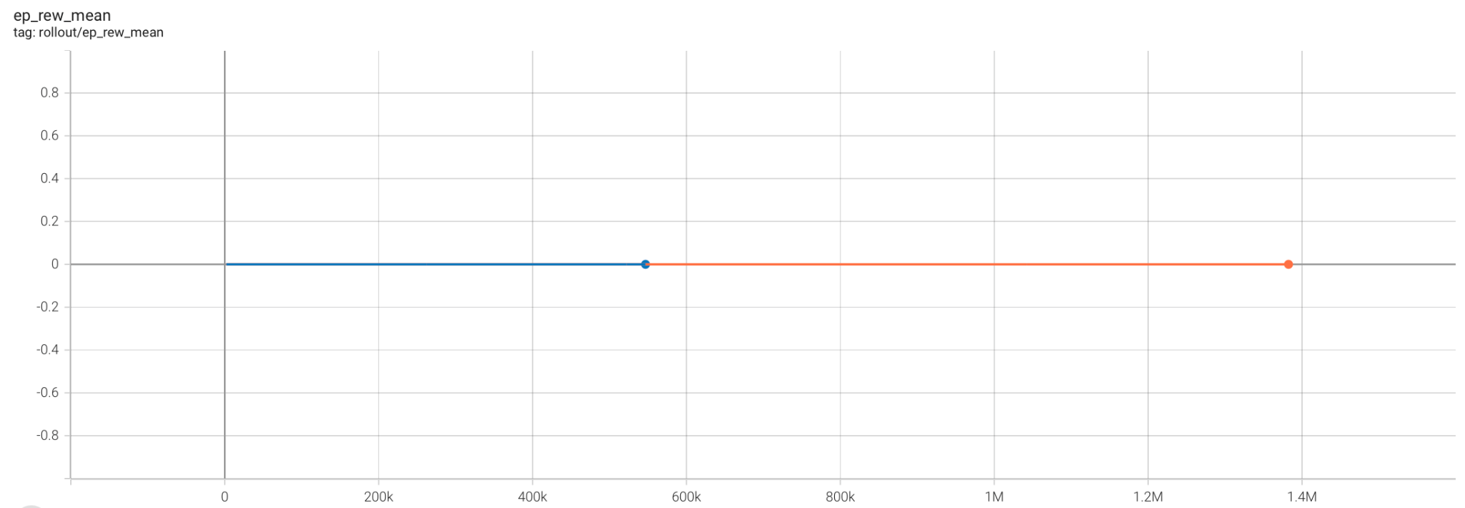
Results
Cartpole - Swingup-sparse task
Baseline
Transfer
Metric | Baseline | Transfer Learning | Improvement
Max Mean Reward | 0.0 | 0.0 | N/A
Steps to High Reward | N/A | N/A | N/A

Slide 30
Results
All Experiments with PPO
Domain | Task | MMR (Baseline) | MMR (Transfer Learning)
Hopper | Walk | 9.3 | 8.5
Reacher | Hard | 15.4 | 17.2
Finger | Turn_Hard | 121.9 | 122.1
Cartpole | Swingup-sparse | 0.0 | 0.0

Slide 31
Results
All Experiments with DDPG
Domain | Task | MMR (Baseline) | MMR (Transfer Learning)
Walker | Walk | 26.3 | 33.8
Reacher | Hard | 11.9 | 14.3
Finger | Turn_Hard | 131.9 | 110.4
Cartpole | Swingup-sparse | 0.0 | 0.0

Slide 32
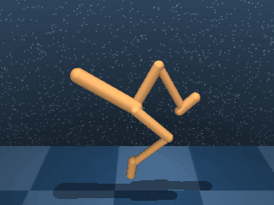
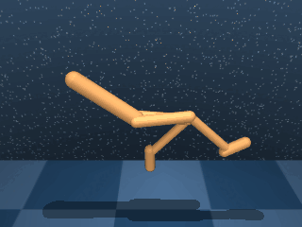
Results
Walker - Walk task GIF
Baseline
Transfer Learning

Slide 33
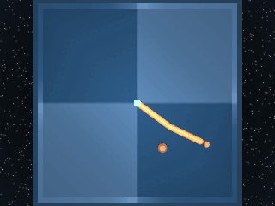
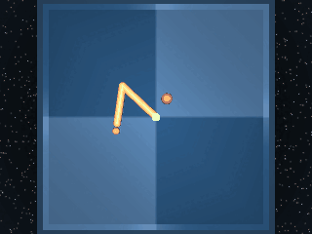
Results
Reacher - Hard task GIF
Baseline
Transfer Learning

Slide 34
Conclusion
05

Slide 35
Conclusion
Work Done & Findings
Successfully trained PPO and DDPG agents on 5 DM Control Suite Domains
Implemented transfer learning by initializing CNN weights from pre-trained agent and compared with random initialization
Transfer learning resulted in higher mean episodic rewards and required lower training steps on average
Walker-walk and Reacher-hard achieve 20%+ higher rewards with TL across both algorithms - could be due to nature of task

Slide 36
Conclusion
Future Work
Training agents for 10M+ steps
Hyperparameter tuning: CNN architecture, Choice of camera angles, Learning rate, Buffer Size, and many more.
Experimenting with different transfer learning strategies
Fine-tuning/freezing layers during training
Cross-domain tasks

Slide 37
Thank you!

